Slide 1
Big Mountain Resort

Slide 2
Problem Identification
Can Big Mountain Resort make the ticket price 10% higher in order to capitalize on their facilities and make the ticket value better.

Slide 3
Problem Identification
Criteria for success: Increase the ticket price by 10% tp provide more value for the ticket
Scope of solution space: Focus on the ticket prices for other resorts with similar facilities and runs
Constraints: Customers not willing to pay for the higher ticket price

Slide 4
Recommendation and Key Findings
Key Findings:
After preforming the model Big Mountain Resort modelled price was $95.87
There was also a potential room for increase of about $10
This suggest that Big Mountain could be under valuing the ticket compared to other resorts with similar runs and facilities
Recommendation:
My recommendation would be to increase the vertical drop by 150 feet and add an additional chair lift.
This would increase the value of the ticket by $1.99 which would increase revenue to $3, 474, 638

Slide 5
Modeling Results and analysis
When grabbing the linear regression model coefficients we found that the vertical drop was the biggest positive feature along with snow making, total chairs, and runs
Vertical_drop 10.767857
Snow Making_ac 6.290074
Total_chairs 5.794156
fastQuads 5.745626
Runs 5.370555
LongestRun_mi 0.181814
Trams -4.142024
SkiableTerrain_ac -5.248780

Slide 6
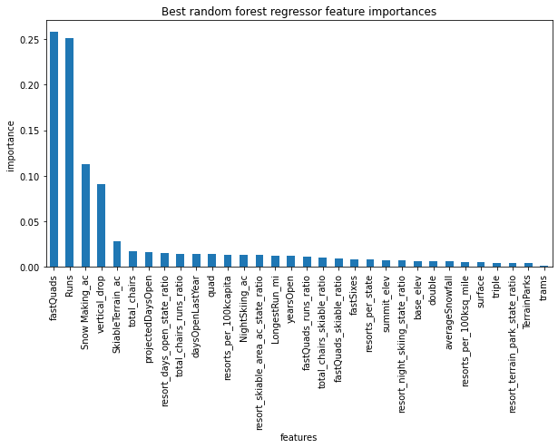
Modeling Results and analysis
Next when running the random forest model we also found that the top 4 most important features were similar to the top 4 positive features in the linear regression model
The top four of importance are fastQuads runs Snow making, and vertical drop

Slide 7
Modeling Results and analysis
Although the linear regression and random forest model gave somewhat similar results
The random forest model mean absolute error was 9.538
The linear regression model mean absolute error was 11.793
So the random forest model was the better choice since the mean absolute error was about $2

Slide 8
Conclusion
I recommend that you should increase your vertical drop by 150 feet and add an additional chair lift
This will lower the operating cost of a new chair lift from $18,500 to $18,000
Also since there is room for increasing the ticket at least $10 this will allow you to raise the ticket price an extra $2.

